Slide 1
Customer Churn Analysis Prediction for ConnectTel Telecom Company
A Comprehensive Analysis of Customer Churn Using Python
Presenter: Essien, Ubon Asuquo
May, 2024

Slide 2
Introduction Problem Definition
Customer churn is the rate at which customers stop doing business with a company over a given period.
High churn rates can indicate customer disatisfaction or better competition.
ConnectTel faces a pressing need to address customer churn which poses a significant threat to business sustainability and growth.
Predicting churn is critical for improving customer retention.

Slide 3
Objectives
Examine the relationship between churn and selected socio-economic variables.
Develop a robust customer churn prediction system.
Identify and visualize the most important variables that affect customer churn.
Make recommendations to connectTel, based on findings from the analysis.

Slide 4
Data Overview
Data Source: Data was obtained from the company, ConnnectTel Telecom Company
Data type: Float64(1), Integer(2), Object(18)
Variables: The key variables in the analysis are: gender, SeniorCitizen, Partner, Dependents, tenure, PhoneService, MultipleLines, InternetService, OnlineSecurity, OnlineBackup, DeviceProtection, TechSupport, StreamingTV, StreamingMovies, Contract, PaperlessBilling, PaymentMethod, MonthlyCharges, TotalCharges and Churn

Slide 5
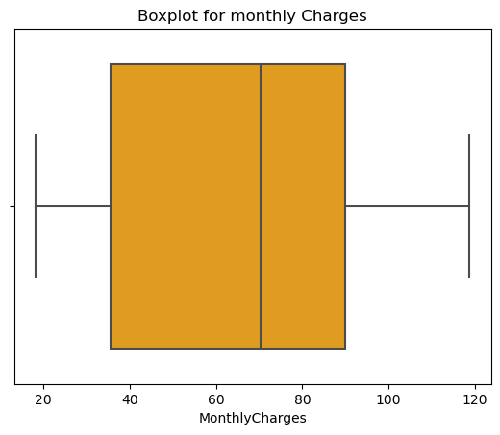
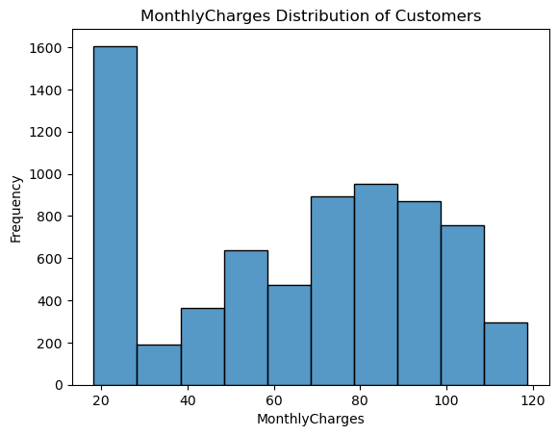
EDA: (Univariate Analysis)MONTHLY CHARGES: Box plot reveals the data is skewed with spread of 20-120. Histogram shows frequency of 1600 when the charges was just between 20 and 30. A normal distribution for monthly charges ranging between 30 and 120 with highest frequency of 1000

Slide 6
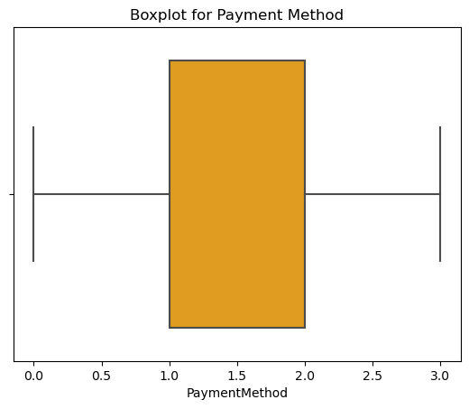
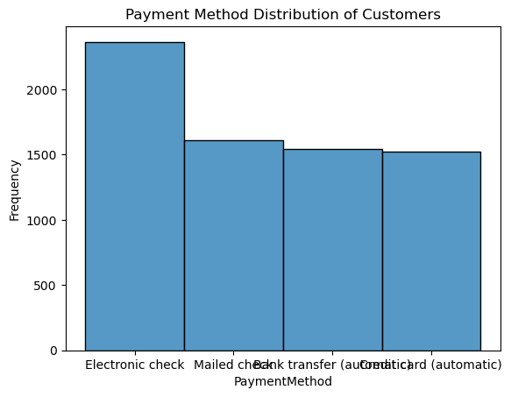
Payment method The histogram here reveals that the electronic payment has the most frequency of more than 2000 compared to other forms of payment

Slide 7
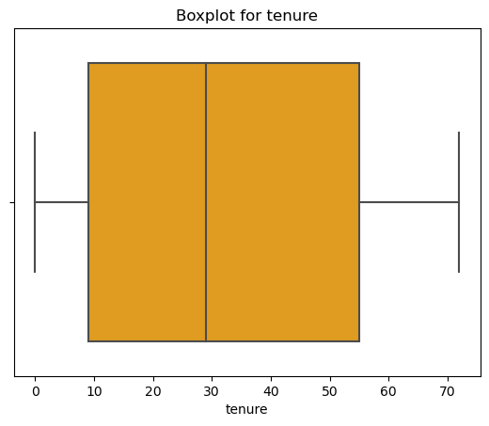
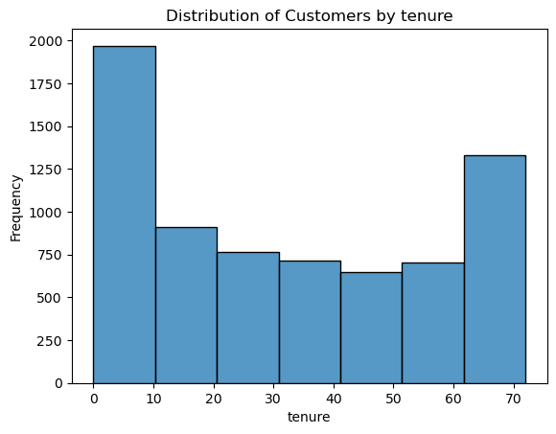
Tenure: The boxplot is skewed with median at 30 Tenure does not follow normal distribution in the histogram

Slide 8
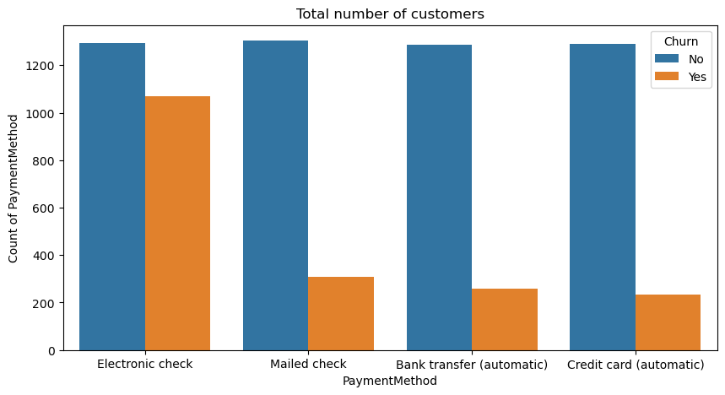
Bivariate Analysis; Payment Method and Churn. More than 1000 customers that use electronic check churned.

Slide 9
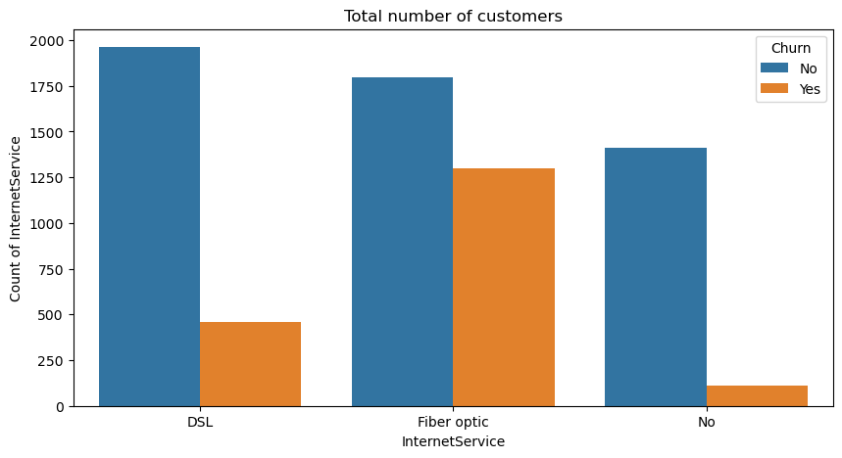
Internet Services and Churn Fiber Optic: More than 1250 customers churned.

Slide 10
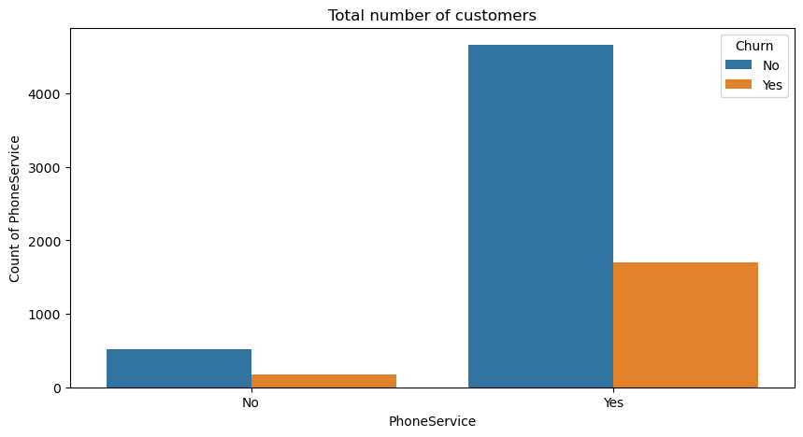
Phone Services and Churn: About 1800 customers that make use of phone services churned.

Slide 11
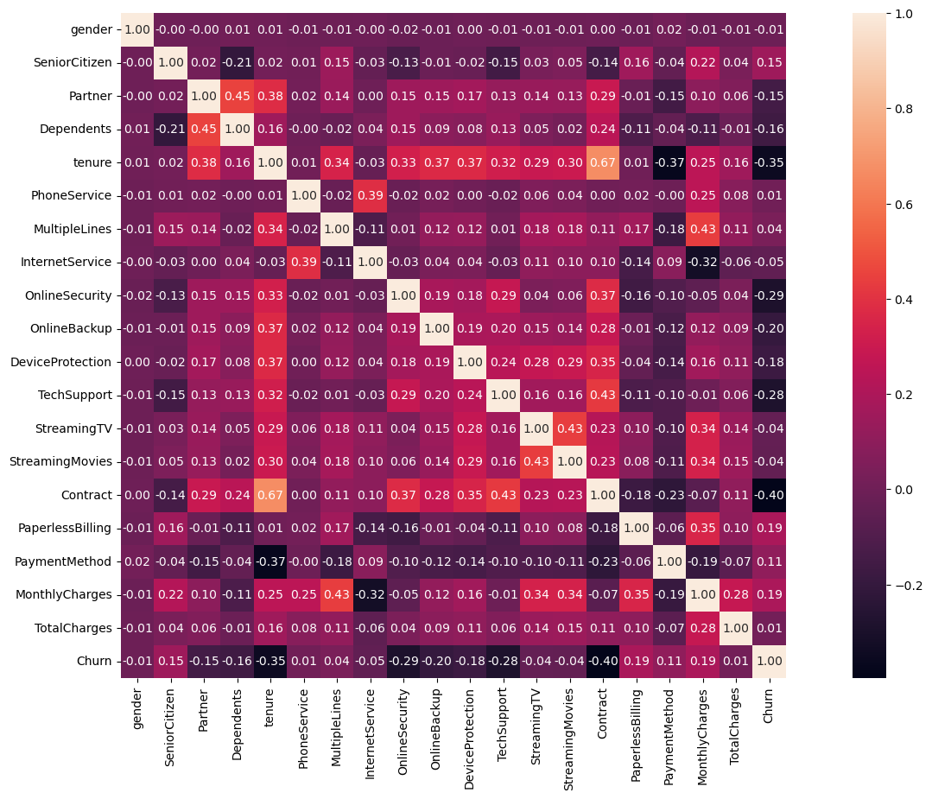
Multivariate: Correlation reveals there is a moderately weak and negative linear relationship between churn and contract with coefficient of -0.40.

Slide 12
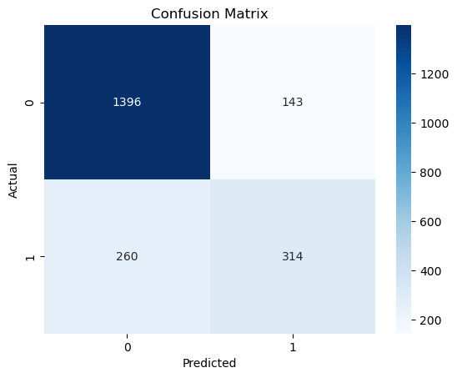
Model Building; Logistic Regression
Logistic Regression
Precision: 0.681
Accuracy: 0.815
Recall: 0.5657
F1-score: 0.618
AUC-ROC: 0.735

Slide 13
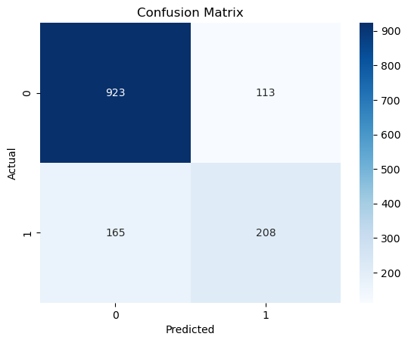
Random Forest Classifier
Random Forest
Precision: 0.648
Accuracy: 0.791
Recall: 0.464
F1-score: 0.540
AUC-ROC: 0.687

Slide 14
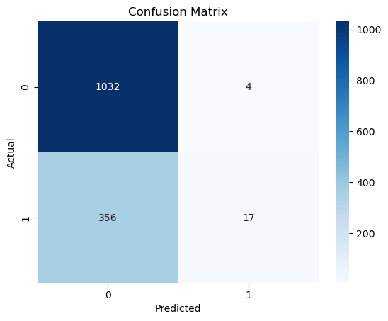
SGD Classifier
SGDClassifier
Precision: 0.681
Accuracy: 0.815
Recall: 0.566
F1-score: 0.618
AUC-ROC: 0.736

Slide 15
Model Performance
Logit.
Strengths: High accuracy (81.48%) and a good AUC-ROC score (0.7351), indicating that it performs well overall in predicting customer churn. The precision (68.06%) is also relatively high, meaning that when the model predicts a customer will churn, it is often correct.
Weaknesses: The recall (56.57%) is somewhat lower, indicating that the model does not catch all churners. This suggests that there might be room for improving the model to better capture those customers who will actually churn.
Random Forest.
Strengths: Reasonably high accuracy (79.13%) and moderate precision (64.79%), indicating that it performs well overall and is fairly reliable when it predicts churn.

Slide 16
Weaknesses: The recall (46.38%) is relatively low, indicating that the model does not catch a significant portion of actual churners. The F1-score (0.5406) and AUC-ROC (0.6865) suggest that there is considerable room for improvement in the model's performance
SGDClassifier
Strengths: The model has high accuracy (81.48%) and good precision (68.06%), suggesting it performs well overall and is reliable when it predicts churn. The AUC-ROC score (73.51%) indicates that the model is effective at distinguishing between churners and non-churners.
Weaknesses: The recall (56.57%) is relatively low, indicating that the model misses a significant portion of actual churners. The F1-score (0.6179) reflects this imbalance between precision and recall.

Slide 17
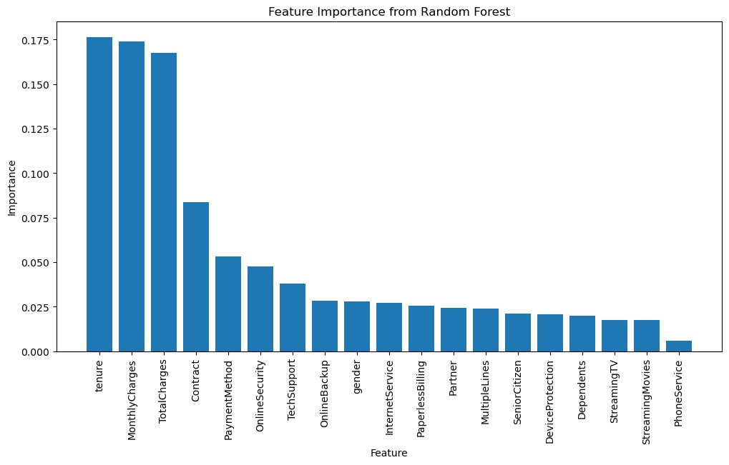
Feature importance from random forest

Slide 18
Insights, Recommendations and conclusion
There is a weak negative correlation between churn and contracts with value of -0.04. It is recommended that the company would strengthen its contract terms.
The confusion matrix from the Random Forest reveals a lower value for FALSE NEGATIVE compared to the other two models. Though this will pose a lesser risk to the company compared to other two models, the model still fails to identify a good number of customers who are actually at risk of churning.
This is disturbing because it means that the company may not be taking proactive measures to retain these customers, potentially leading to revenue loss and reduced customer satisfaction.
However, due to the insights gotten from the feature importance, targeted retention strategies and interventions for customers identified as high-risk churners would be developed

Slide 19
Thank you

